Slide 1
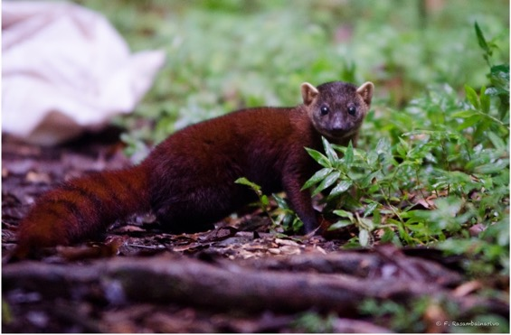
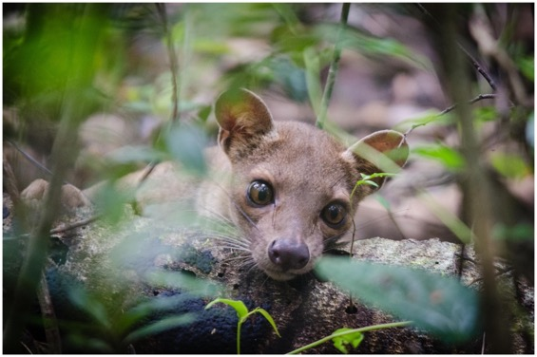
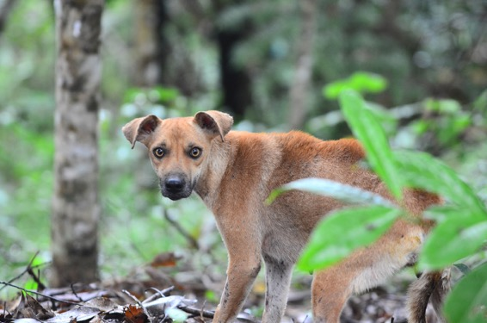





Interactions and pathogen transmission between introduced and endemic carnivores in betampona, Madagascar
Fidisoa Rasambainarivo, DVM, MSc., PhD

Slide 2
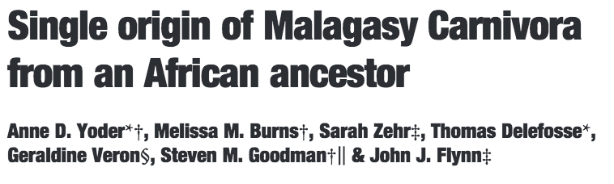
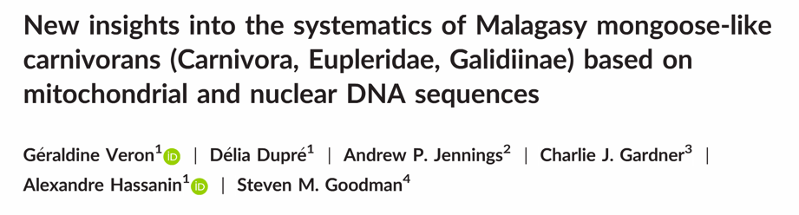
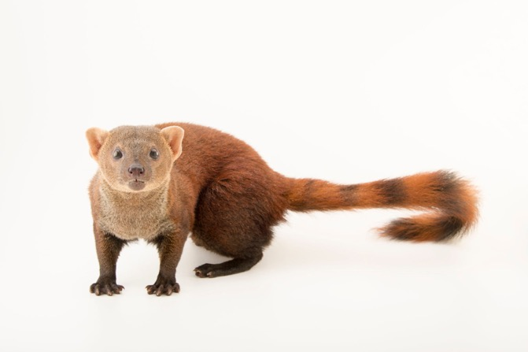
The Eupleridae of Madagascar
J. Sartore ©
J. Sartore ©
J. Sartore ©

Slide 3
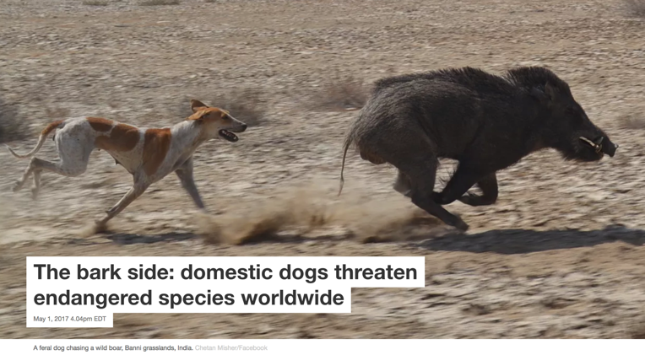
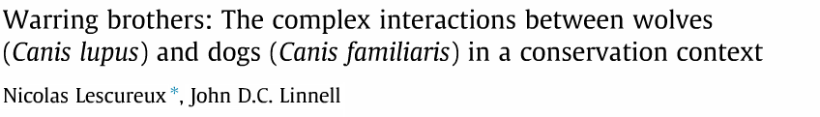
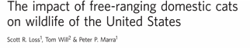
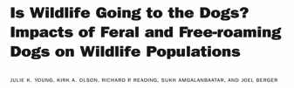
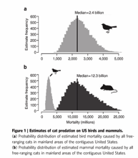
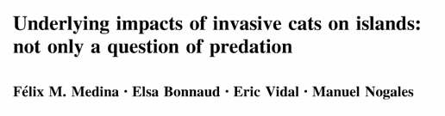
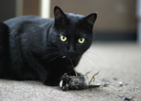
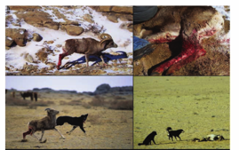
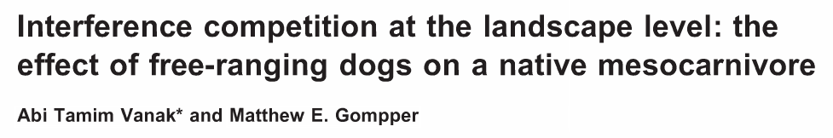
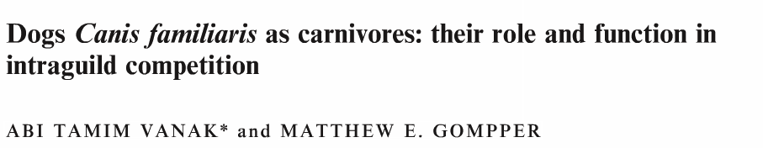
Dogs and cats as invasive species

Slide 4
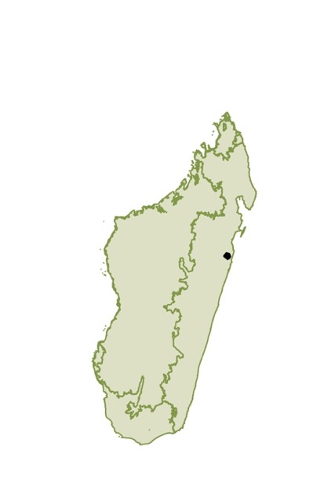

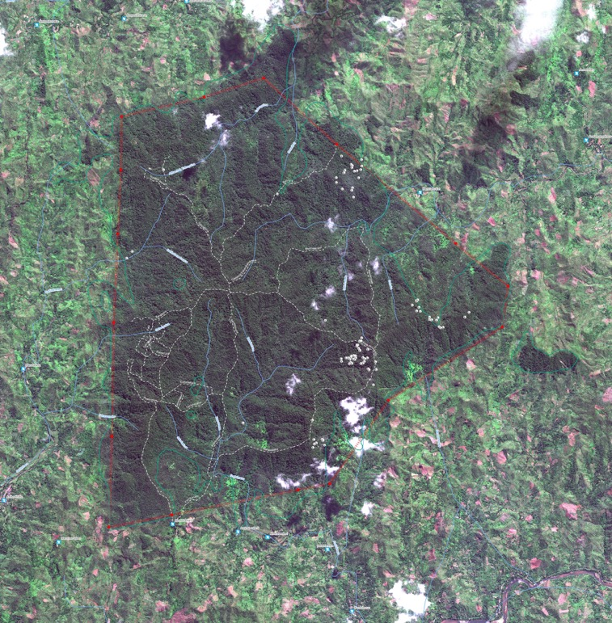
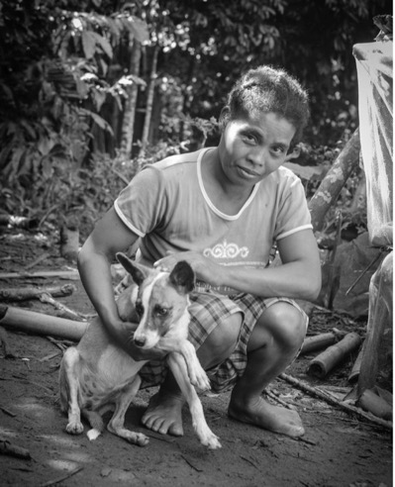
Betampona Natural Reserve

Slide 5
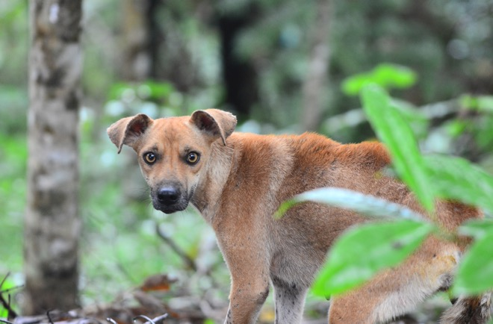
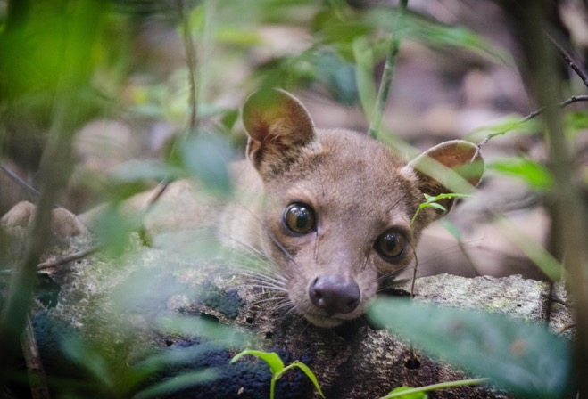
outline
Are domestic and endemic carnivores exposed to similar pathogens?

Slide 6
outline
Spatio-temporal Interactions between introduced and endemic carnivores.
Patterns of exposure to pathogens in sympatric carnivores.
Microbial transmission network among sympatric carnivores

Slide 7
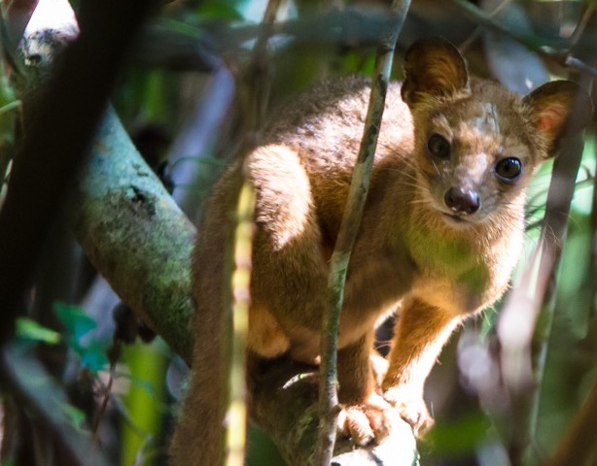
Exposure to pathogens
Specific objectives:
Estimate the prevalence of antibodies to selected pathogens in introduced and endemic carnivore species in Betampona
Identify risk factors and variables associated with exposure to selected pathogens
In western Madagascar, Adult fosa were more likely to be exposed to Toxoplasma than younger individuals. We expected to find similar results in Eastern Madagascar.
Behavioral differences may facilitate the exposure of specific species to pathogens.
Are animals living near each other more likely to share the same status (Seropositive/Seronegative)?

Slide 8
Exposure to pathogens
Specific objectives:
Estimate the prevalence of antibodies to selected pathogens in introduced and endemic carnivore species in Betampona
Identify risk factors and variables associated with exposure to selected pathogens
In western Madagascar, Adult fosa were more likely to be exposed to Toxoplasma than younger individuals. We expected to find similar results in Eastern Madagascar.
Behavioral differences may facilitate the exposure of specific species to pathogens.
Are animals living near each other more likely to share the same status (Seropositive/Seronegative)?

Slide 9
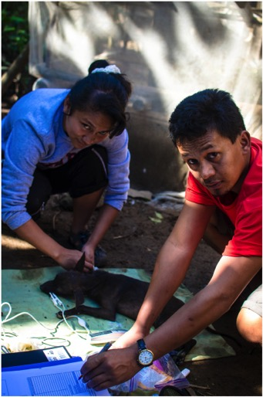
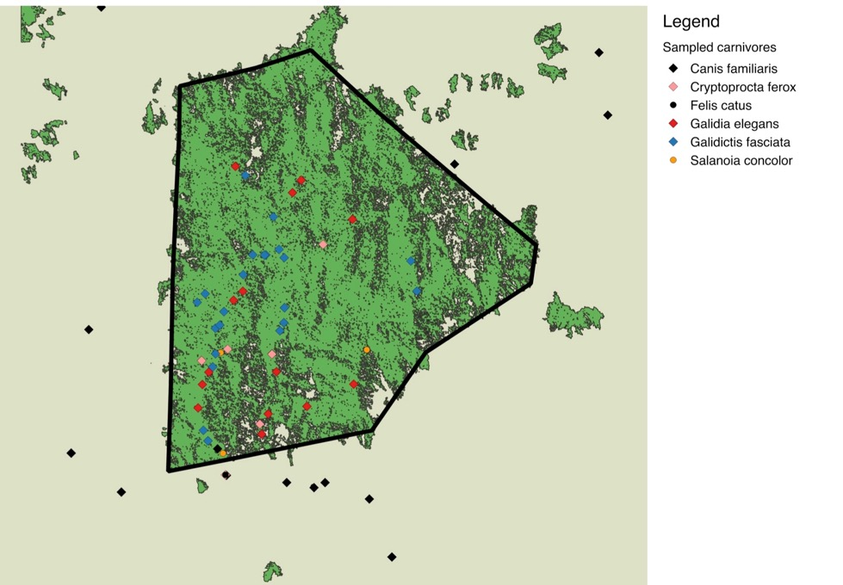
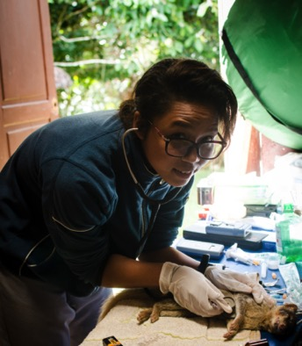

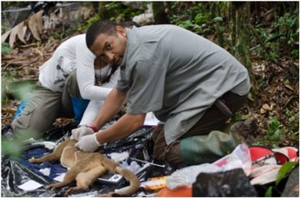
Exposure to pathogens
Animal captures
4 Eupleridae species
Domestic dogs and cats
Serological analyses
- CDV, CPV, FPV, FIV, FeLV, FCV
- Leptospira spp. (5 serovars) - Toxoplasma gondii

Slide 10
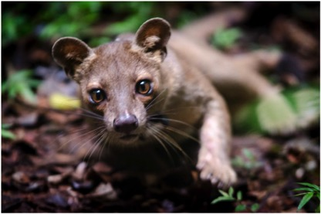
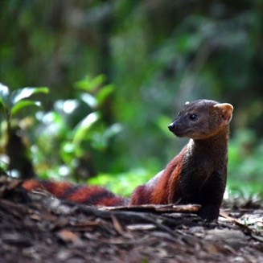
Exposure to pathogens: seroprevalence
Rabe Franck ©
Rasambainarivo F et al., 2018

Slide 11
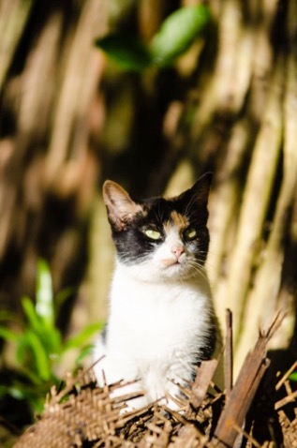
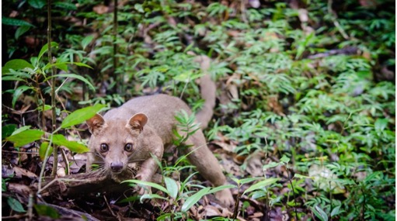
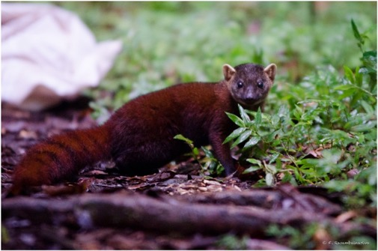
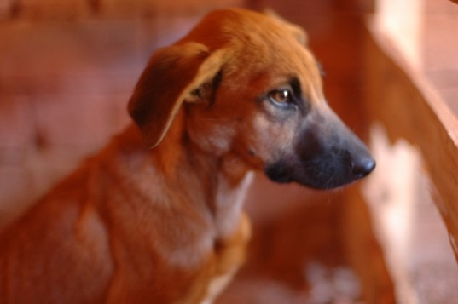
Pathogen spillover

Slide 12
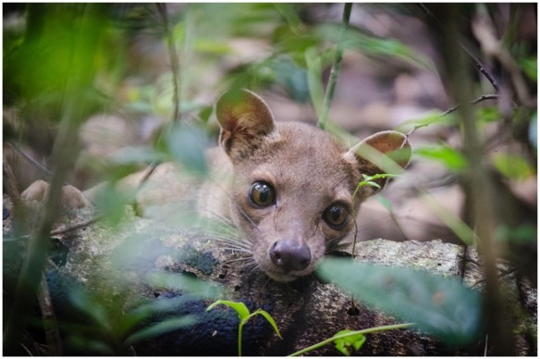
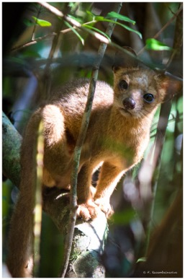
Exposure to pathogens : risk factors
Toxoplasma and Leptospira
Multiple logistic regression models
Independent variables:
- Species
- Age
- Sex
- Distance to research station
- Distance to closest village
- Distance to edge of forest
- Exposure to other virus/parasite/bacteria

Slide 13


Exposure to pathogens : risk factors
Toxoplasma and Leptospira
Multiple logistic regression models
Independent variables:
- Species
- Age
- Sex
- Distance to research station
- Distance to closest village
- Distance to edge of forest
- Exposure to other virus/parasite/bacteria
Rasambainarivo F et al., 2018

Slide 14
Exposure to pathogens : risk factors
Toxoplasma and Leptospira
Multiple logistic regression models
Independent variables:
- Species
- Age
- Sex
- Distance to research station
- Distance to closest village
- Distance to edge of forest
- Exposure to other virus/parasite/bacteria
OR=4.13 p-value=0.03
Rasambainarivo F et al., 2018

Slide 15
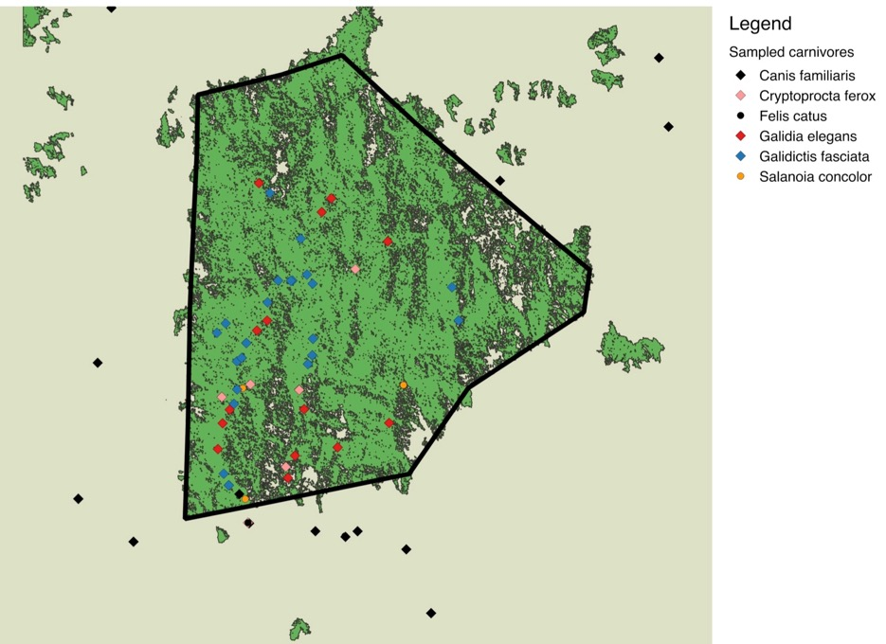
Exposure to pathogens : risk factors
Spatial autocorrelation
Are animals living near each other more likely to share the same status (Seropositive/Seronegative)?
Partial Mantel’s test
Similarity of pathogen exposure= Distance + Species similarity
P-value=0.4
Rasambainarivo F et al., 2018

Slide 16
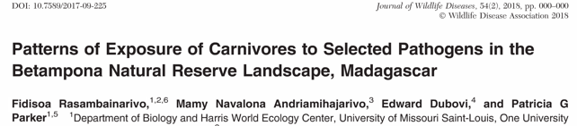
Exposure to pathogens : risk factors
Spatial autocorrelation
Are animals living near each other more likely to share the same status (Seropositive/Seronegative)?
Partial Mantel’s test
Similarity of pathogen exposure= Distance + Species similarity
P-value=0.4
Rasambainarivo F et al., 2018

Slide 17
outline
Spatio-temporal Interactions between introduced and endemic carnivores.
Patterns of exposure to pathogens in sympatric carnivores.
Molecular evidence of infection by tick-borne pathogens

Slide 18
Piroplasmid+anaplasmataceae
Piroplasmid:
- Tick borne protozoan parasites that infect blood cells of animals including humans.
9 Babesia, 2 Theileria and 2 Cytauxzoon and 1 Rangelia
Anaplasmataceae
- Gram negative
Intracellular obligate
4 Genera (Anaplasma, Rickettsia, Wolbachia and Neorickettsia)

Slide 19
Piroplasmid+anaplasmataceae
Piroplasmid:
- Tick borne protozoan parasites that infect blood cells of animals including humans.
9 Babesia, 2 Theileria and 2 Cytauxzoon and 1 Rangelia
Anaplasmataceae
- Gram negative
Intracellular obligate
4 Genera (Anaplasma, Rickettsia, Wolbachia and Neorickettsia)
Haemyphisalis obtusa

Slide 20
PCR tests
To detect molecular evidence of infection by these parasites in domestic and wild carnivores of Betampona
 | n | Piroplasmid | Anaplasmatacea
Domestic dogs | 22 | 0 (0-18%) | 9 (2-30%)
Galidia elegans | 14 | 100 (73-100%) | 57 (30-81%)
Galidictis fasciata | 17 | 90 (66%-98%) | 29 (11-55%)
Cryptoprocta ferox | 6 | 100 (52-100%) | 17 (01-63%)

Slide 21
PCR tests
To detect molecular evidence of infection by these parasites in domestic and wild carnivores of Betampona
Anaplasmatacea
95% similarity with Anaplasma bovis
Piroplasmid
- 95% similarity with Cytauxzoon felis
 | n | Piroplasmid | Anaplasmatacea
Domestic dogs | 22 | 0 (0-18%) | 9 (2-30%)
Galidia elegans | 14 | 100 (73-100%) | 57 (30-81%)
Galidictis fasciata | 17 | 90 (66%-98%) | 29 (11-55%)
Cryptoprocta ferox | 6 | 100 (52-100%) | 17 (01-63%)

Slide 22
futher
Study whether these tick borne parasites are shared between multiple species (including lemurs).
Negative effect of these parasites on the health of infected animals?

Slide 23







Thank you
Advisor : Dr Patricia Parker
Committee members: Dr Gompper Dr Marquis Dr Ricklefs Ingrid Porton (MFG) Eric Miller (MFG/St Louis Zoo)
Field crew: Hertz, Mihaja, Natacha, Torisy and Flavien
Liz Toomey
Parker lab and Cindee

